Slide 1
Internet of Things
Project
CSE-3009
Group Members:
Akash Manish Lad
Ram Kumar
Chris Nikhil
Sudharshan Rahgu

Slide 2
IoT-based
Face Recognition
for
Attendance System

Slide 3


Project Aim
To build automated Attendance system to prevent time-wastage in classrooms
Ease out the process of Manual Attendance
On-Cloud Analytics and Report Generation

Slide 4
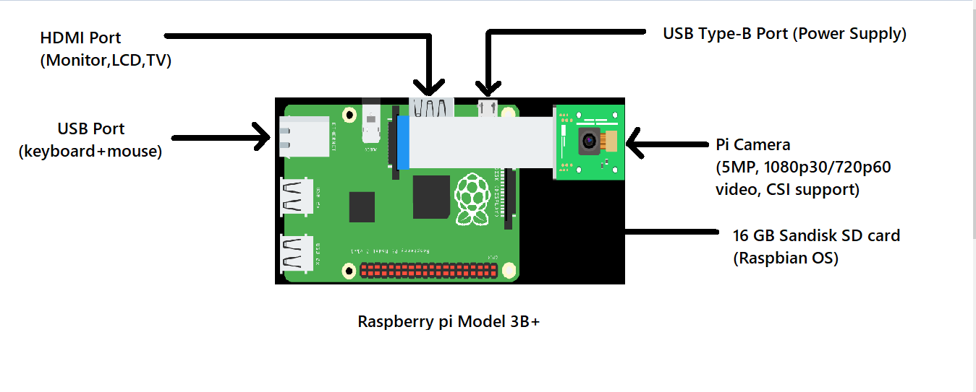
Diagrammatic Representation

Slide 5
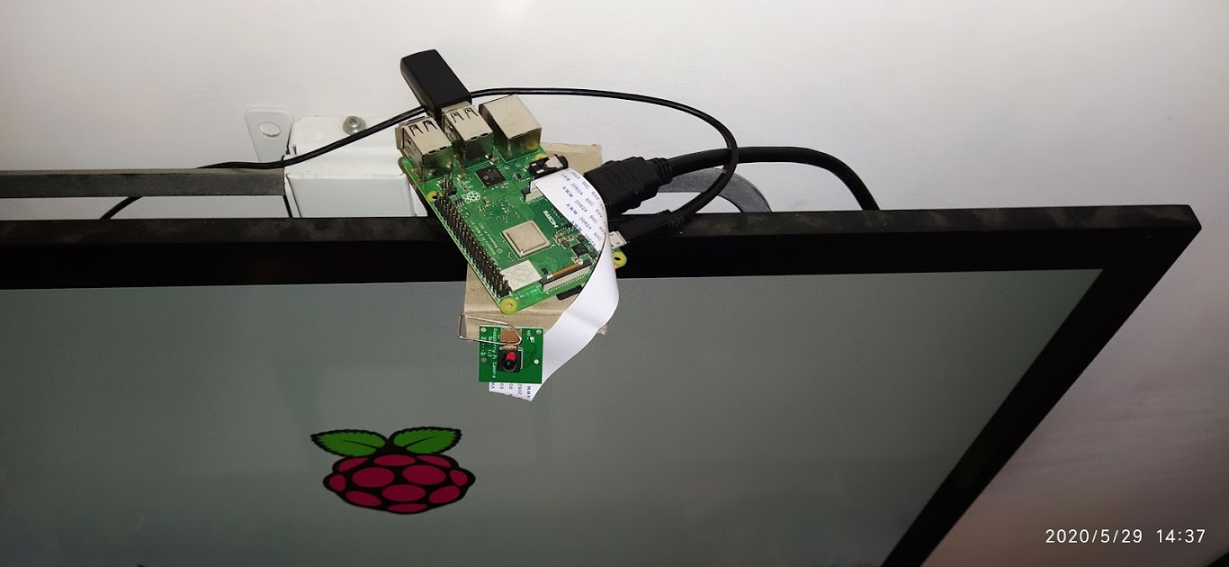
Project Set-up

Slide 6
Project Cost
Raspberry pi 3B+ -----------------------₹ 3000/-
16 GB Sandisk SD Card----------------₹ 250/-
HDMI Cable------------------------------₹ 120/-
USB Type-B micro Cable---------------₹ 40/-
USB Adapter (keyboard+mouse)-----₹ 1950/-
Monitor Display-------------------------₹ 1500/-
Net Total: ₹ 6860 /-

Slide 7

Raspberry pi will be used as an IoT device to get local data by constructing a face recognition architecture.
Part 1 - IoT device setup
Part 2 - Face recognition setup
Part 3 - AWS Analytics

Slide 8

Setting up OS for Raspberry pi
→ Downloading Raspbian Image
→ Flashing the OS image to the SD card on Raspberry pi
→ Etcher for Windows
→ Wait about 5~10 minutes
→ OS installation Completed

Slide 9
Hardware/Software for Raspberry pi
Raspberry Pi Wifi Setup
Raspberry Pi Packages Installation
Setup AWS Credential On Your Raspberry Pi

Slide 10
Setting up Quicksight Dashboard
Setting AWS Credential On Computer/Laptop
Install Certificate Into Your Pi
With credentials like :
Public user key
Private user key

Slide 11
Software used
Python 3.7
OpenCV (Image Detection & Recognition)
Tkinter (Attendance UI)
Numpy, Pandas (Image/data processing)
Datetime, csv (records time-in/out with name in CSV )
AWS Cloud Service
Security certificate set-up
Purchasing appropriate service
Signing-up Dashboard

Slide 12
Face Recognition Algorithm
LBPH Algorithm (Local Binary Patterns Histogram algorithm)
Algorithm uses 160,000 features
4 primary steps of implementation of Face Recognition Algorithm
Selection of Haar features
Integral images
Adaboost
Cascade Classifier

Slide 13
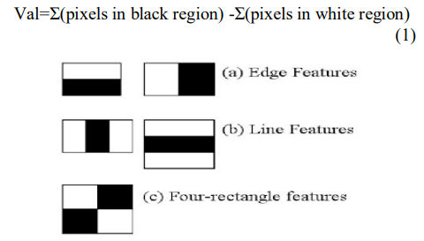
Haar features
similar to these convolution kernels
calculated by subtracting the sum of pixels under white rectangle from the sum of pixels under black rectangle.

Slide 14
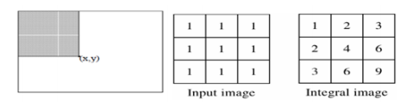
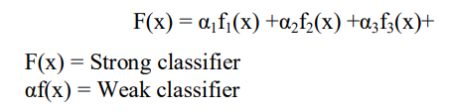
Integral Images
Generates the sum of values in a rectangular subset of a grid in the image processing domain it is known as integral image
Adaboost
The output of the other learning algorithms ('weak learners') is combined into a weighted sum that represents the final output of the boosted classifier.

Slide 15
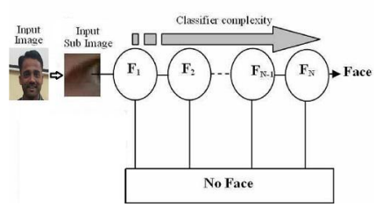
Cascade Classifier
Comprises of composition of all stages containing strong classifier where all the features are combined in different stages
Determines whether an image is face or not

Slide 16
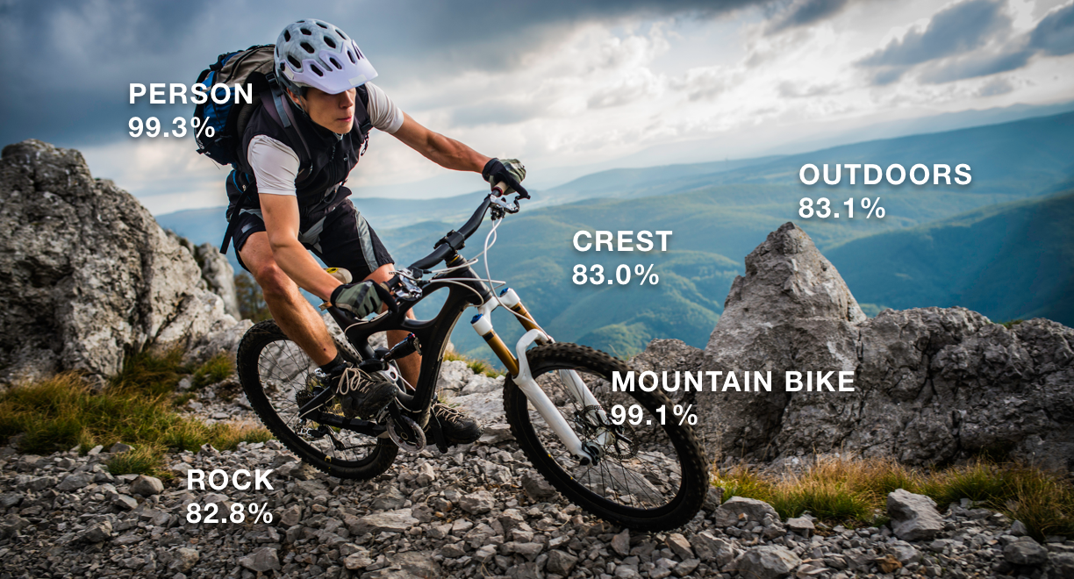
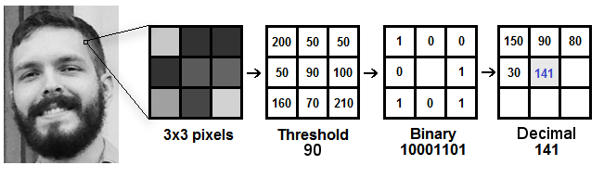
Working & Accuracy of LBPH

Slide 17
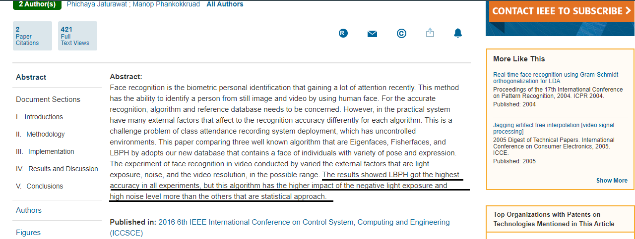
IEEE ref. for efficient accuracy of
LBPH Algorithm

Slide 18

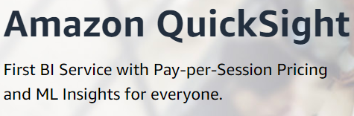
AWS Cloud Services
Among various available service we decided:
“ AWS- Quicksight ”
Billed at $0.30 /session

Slide 19
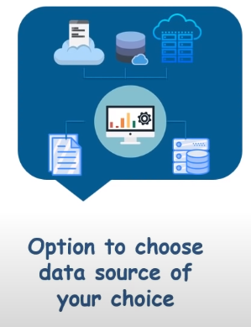
Quicksight Features

Slide 20
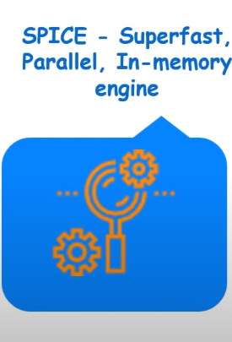
SPICE Engine (superfast/viable)

Slide 21
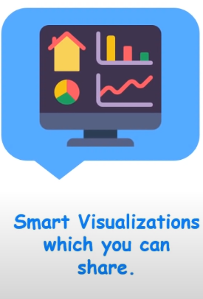
Quicksight Analytics (smart/adaptive)

Slide 22
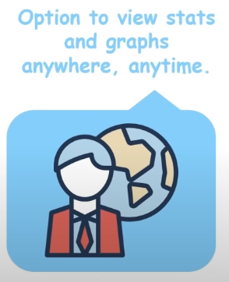
Quicksight Easy-share
(Supported across various platforms)

Slide 23
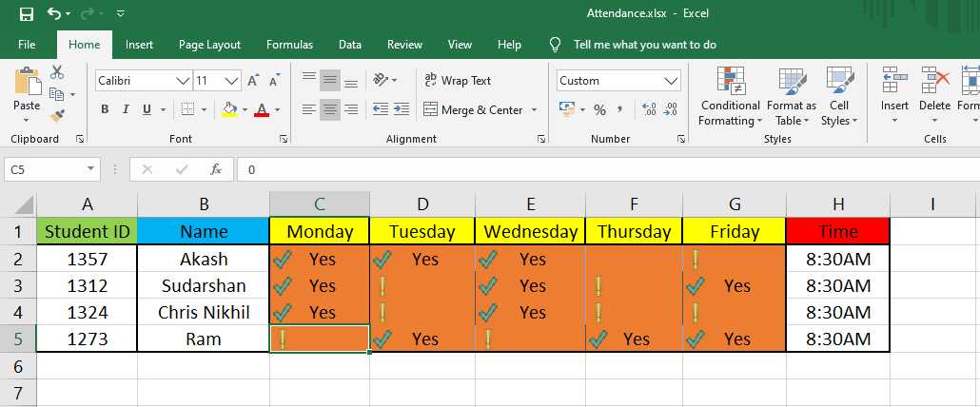
Quicksight Hands-on

Slide 24
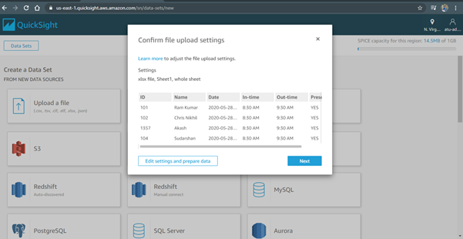
Uploading Data
(.csv, .tsv, .json, .xlsx)

Slide 25
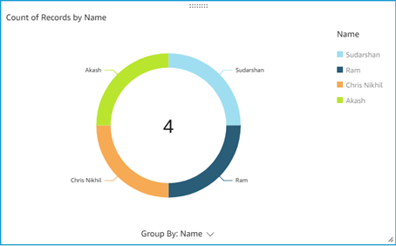
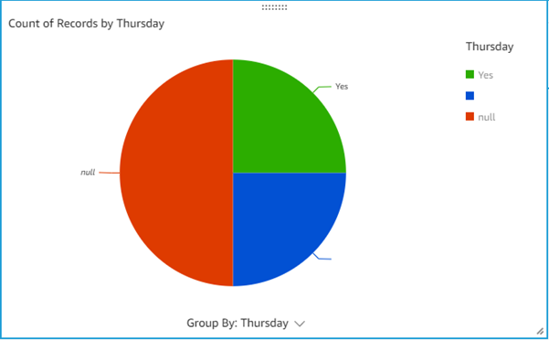
Quicksight Dashboard Analytics(1/2)
Fig 1.1
Fig 1.2

Slide 26
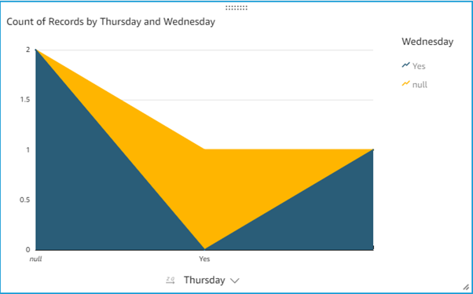
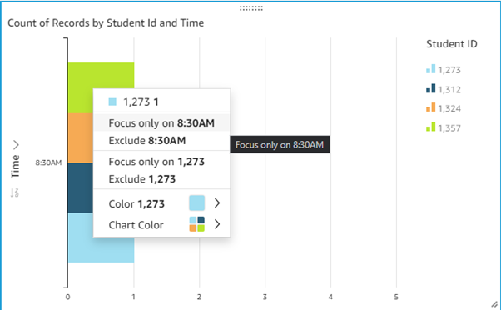
Quicksight Dashboard Analytics(2/2)
Fig 1.4
Fig 1.3

Slide 27
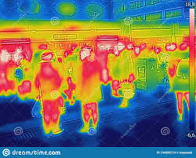
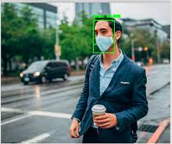
Future Work
In consideration with Post COVID-19
Thermal Screening and Mask Detection for Attendance & Reporting
Using Infrared Sensors and High Quality Camera for measuring temperature and image recognition
Reporting nearby Medical centre in case of Emergency and health-care hospitality

Slide 28
References
IoT attendance system
https://www.ijitee.org/wp-content/uploads/papers/v8i6s4/F10930486S419.pdf
Accurate & Optimised Face Recognition research paper
https://ieeexplore.ieee.org/xpl/conhome/7889414/proceeding
LBPH Based Improved Face Recognition At Low Resolution
https://www.researchgate.net/publication/327980768_LBPH_Based_Improved_Face_Recognition_At_Low_Resolution
Opencv Documentation: https://docs.opencv.org/
AWS-Quicksight User Guide: https://docs.aws.amazon.com/quicksight/latest/user/welcome.html
YouTube Tutorials for Raspberry pi Configuration: https://www.youtube.com/watch?v=RpseX2ylEuw&list=PLQVvvaa0QuDesV8WWHLLXW_avmTzHmJLv

Slide 29
Thank You
for
providing this opportunity!

